Slide 1
Module 1
Project management
Part 1

Slide 2

What is a project?
A project is a temporary enterprise designed to create unique products, services, or results.

Slide 3
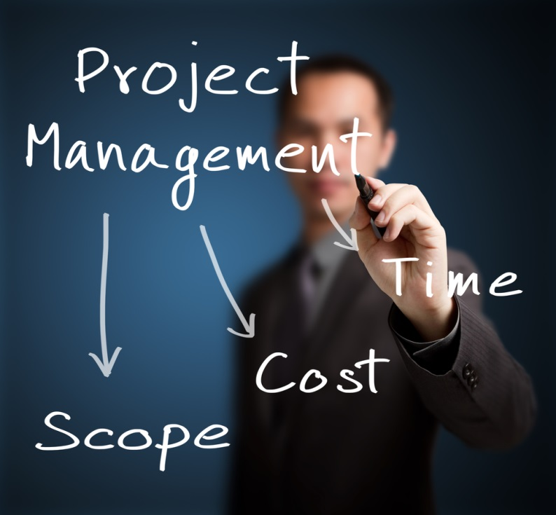
Project management?
Project management - the application of knowledge, skills, tools and methods to the work of the project to meet the requirements for the project.

Slide 4

A program is a series of interconnected subprogramms and activities, the management of which is coordinated to achieve the benefits and degree of control that are not available when managing them separately.

Slide 5

A portfolio is a set of projects, programs and operations that are combined together with the goal of effective management to achieve strategic goals.

Slide 6
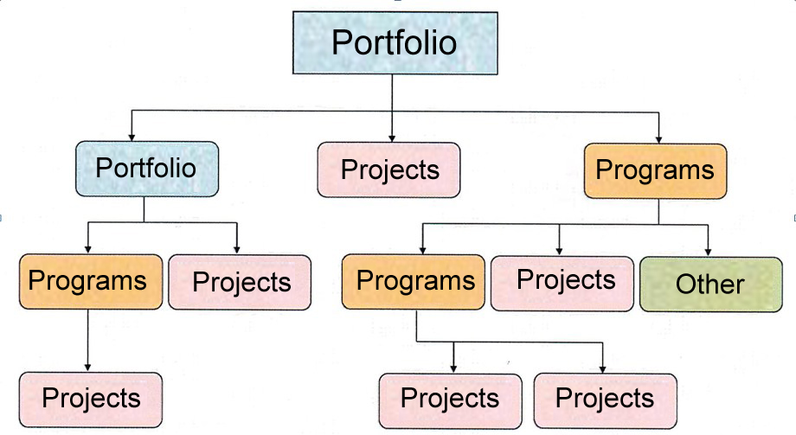
Portfolio and Components Relations

Slide 7
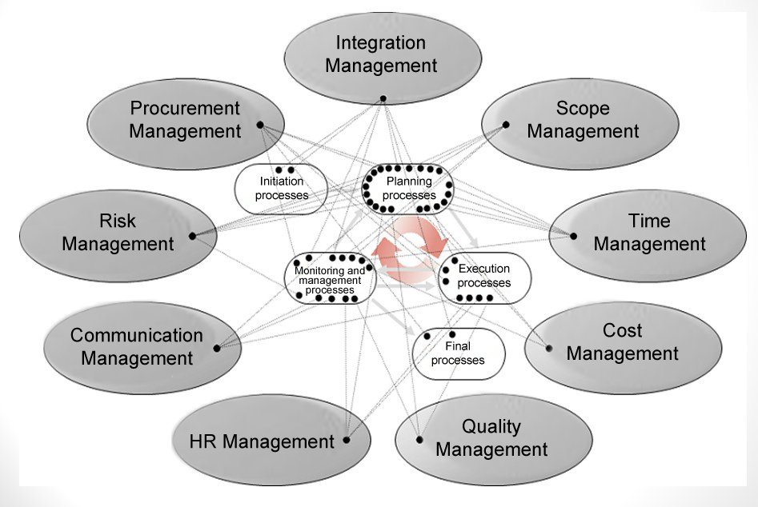
Project Management Processes

Slide 8
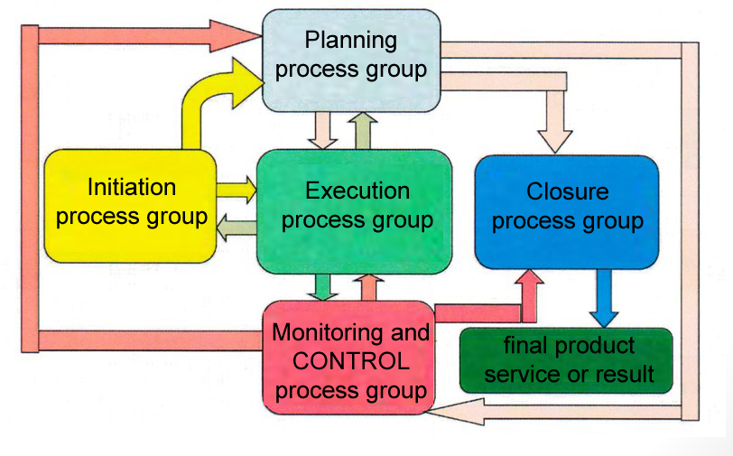
Project Management Process Groups

Slide 9
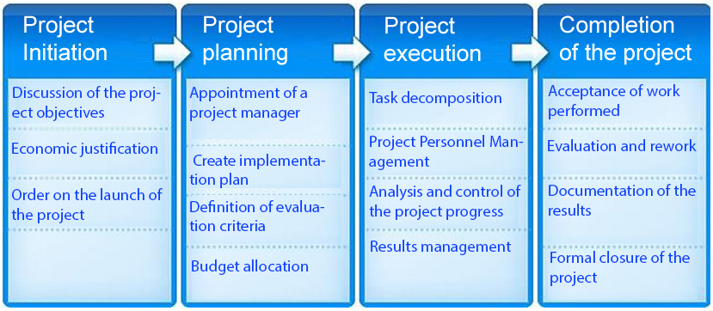

Slide 10
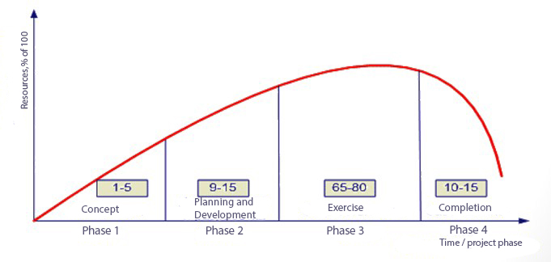
A project life cycle is a set of, as a rule, consecutive and sometimes overlapping project phases.

Slide 11

Process - a set of interrelated actions and operations carried out to obtain a predetermined product, result or service.

Slide 12
5 groups of processes: initiation, planning, execution, monitoring and control, project closure.
10 areas of knowledge: management of integration, content, timing, cost, quality, human resources, communication, risk, procurement, project stakeholders.
47 project management processes.

Slide 13
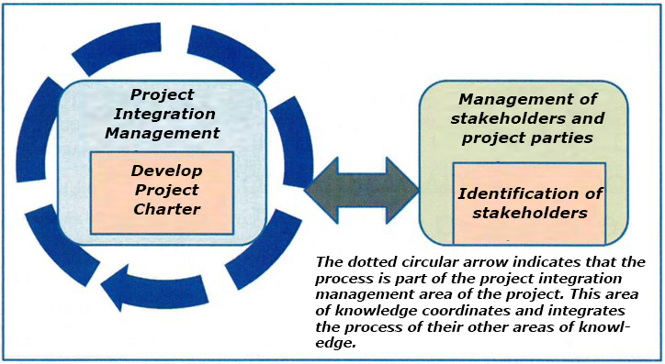

Slide 14
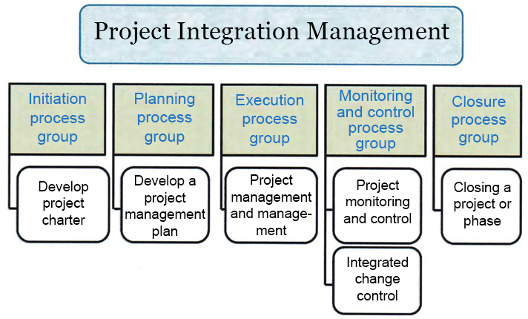

Slide 15
The Develop Project Charter is the process of developing a document that formally authorizes a project and gives the project manager the authority to use the organization’s resources for project operations.

Slide 16
The project charter documents:
- appointment or justification of the project;
- measurable project objectives and relevant success criteria;
- high level requirements and risks;
- high-level project description;
- free schedule of control events;
- free budget;
- project approval requirements (which is a success of the project, who decides that the project was successful, and who signs the project).
- appointed project manager, level of responsibility and authority;
- the name and authority of the sponsor or other person approving the project charter.

Slide 17
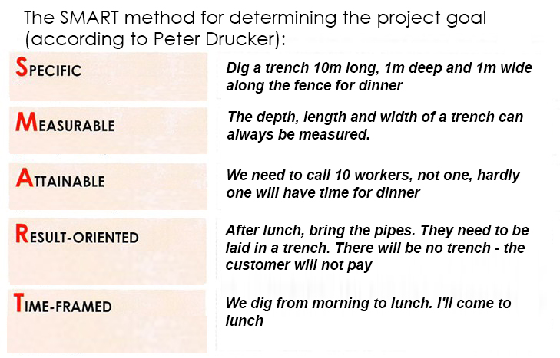

Slide 18
A constraint is a limiting factor affecting the progress of a project’s execution or process. The constraint describes certain external or internal boundaries or restrictions related to the content of the project.
Assumptions are factors that are considered to be true, real, or defined for planning purposes without providing evidence or demonstration.

Slide 19
THANKS FOR ATTENTION!!!

